Slide 1

Jal Rekha
OIC: Dr. Rakesh Dubey
PM : Mr. Tapan Khandelwal

Slide 2
Introduction
Jal Rekha is a GIS-based integrated mobile and web application developed for end-to-end monitoring, planning, and management of rural water supply projects across the state, including schemes under Har Ghar Jal Yojana. The platform provides a digital system of record to track physical progress, asset creation, inspections, and operational data in a transparent and standardized manner.
The solution enables field-level data capture through a mobile application, allowing geotagging of assets such as intake points, WTPs, OHTs, pipelines, and beneficiary connections. This supports accurate visualization of planned versus actual network layouts on GIS maps, ensuring data authenticity and quality control.
The web application acts as a centralized monitoring and governance platform for departmental users, facilitating task assignment, inspection approvals, progress tracking, and reporting at state, district, scheme, and village levels. Jal Rekha also enables contractors to digitally raise inspection requests, streamlining verification workflows, improving turnaround times, and enhancing transparency.
Additionally, the platform supports meter reading uploads for real-time water supply monitoring and data-driven contractor payments. As a planned enhancement, Jal Rekha aims to empower citizens.
Project Start Date: 15-Jan-2024
Project End Date: On-going
Current Status:
Total Schemes: 147
Total Web Users: 905
Total Mobile Users: 5,255
Total RFIs Raised: 370,205
Total Schemes RFIs Generated: 113
Total NGO Activities Recorded: 160,378
Technology Stack | Technology Stack
Framework | .NET Core (8)/ Angular,
Database | PostGres SQL
Daily Inspections Conducted: 126,740
Total Pipeline Mapped: 130,492 km
Total Assets Surveyed (Intake, WTP, MBR, OHT, IPS, PMBR): 12,286
Total Water Samples Collected: 18205
Daily Water Supply Villages Meter Readings: 3110
Schemes under O&M: 54
Factory Material Tests Conducted: 45
Total functional household tap connection Survey : 25004

Slide 3
Team Structure
Database Developer
Tech Lead
Developer
Senior Developer
Tester
Senior Business Analyst
Managing Director
OIC
Project Manager

Slide 4
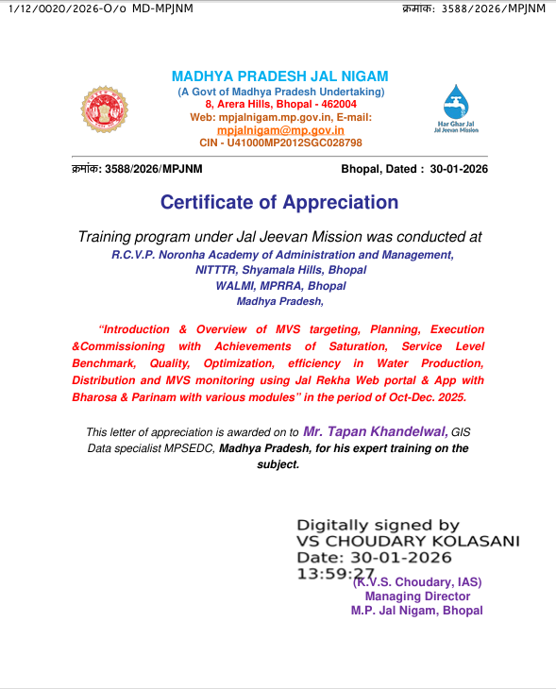
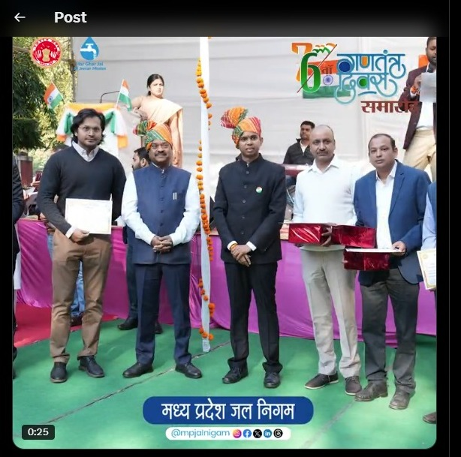
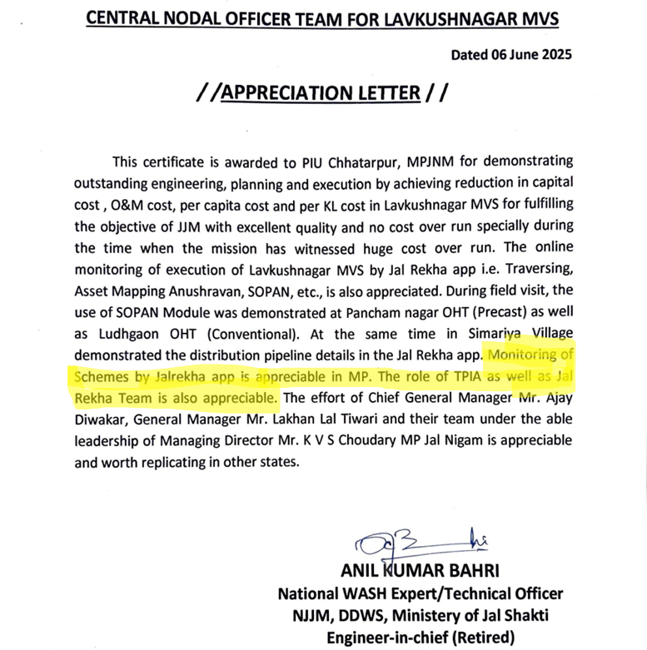
Awards Acclodes
Central Repository SVN Awards Appreciation link :
https://172.18.200.175/svn/GIS_MAPIT/code/JalNigam/CMMI_L5_Documents/Appreciations

Slide 5
Requirements
Scope of Work:
The Jal Rekha Project is a GIS-enabled web and mobile platform developed to support end-to-end planning, monitoring, and governance of water supply and water quality infrastructure projects. The system enables field-level data collection, asset mapping, water quality monitoring, and role-based approvals through an integrated digital workflow.
Its scope includes mobile surveys with GPS and photo validation, water quality sample collection and reporting, contractor work plan, capture NGO activities, and web-based dashboards and reports for real-time monitoring
<Change Request Log> in case of CR’s in the projects
SRS/FRS : https://172.18.200.175/svn/GIS_MAPIT/code/JalNigam/CMMI_L5_Documents/Requirements Development & Management/SRS
User Stories: https://172.18.200.175/svn/GIS_MAPIT/code/JalNigam/CMMI_L5_Documents/Requirements Development & Management/US
BRTM: https://172.18.200.175/svn/GIS_MAPIT/code/JalNigam/CMMI_L5_Documents/Requirements Development & Management/BRTM
<Put some sample Screen reference and than attach a link of the file from the central repository>

Slide 6
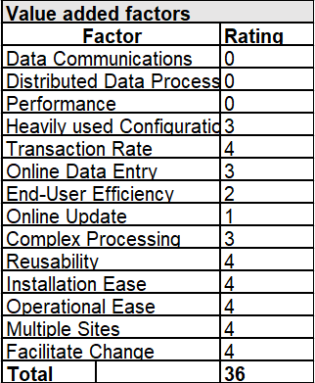
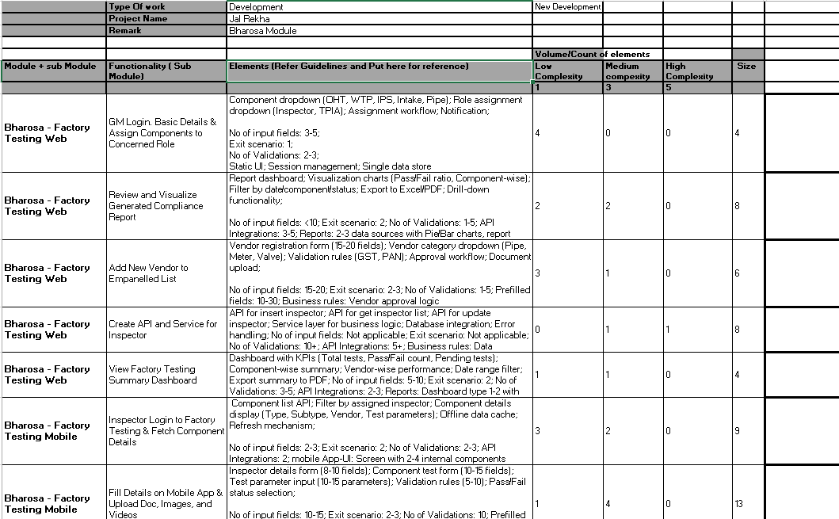
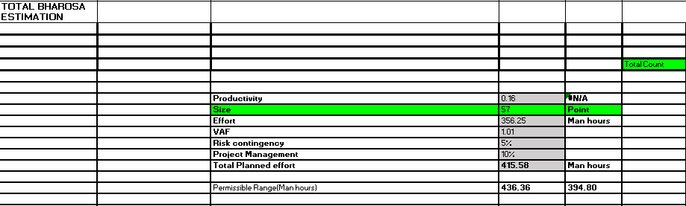
Estimation
Estimates are done using Story Point Size-based estimation technique (by PM/TL/BA)
Central Repository : https://172.18.200.175/svn/GIS_MAPIT/code/JalNigam/CMMI_L5_Documents/Estimation

Slide 7
Planning / WBS
Project Activity Plan
Type of Project: Team-Based Project
WBS is maintained in : https://promot.mp.gov.in/ and
https://172.18.200.175/svn/GIS_MAPIT/code/JalNigam/CMMI_L5_Documents/WBS
The Project tasks are managed using Promot. The progress of the tasks is reviewed by
the team PM/ leads.
Estimation Technique: Story Point (Size-Based Estimation) : https://172.18.200.175/svn/GIS_MAPIT/code/JalNigam/CMMI_L5_Documents/Estimation
<Demonstrate the Project Activity Plan>
MoM : https://172.18.200.175/svn/GIS_MAPIT/code/JalNigam/CMMI_L5_Documents/Monitor & Control/MOM
CAR : https://172.18.200.175/svn/GIS_MAPIT/code/JalNigam/CMMI_L5_Documents/Casual Analysis Resolution
Process Performance Model: The performance model will be used for estimating the efforts and defects.
Project Plan is consolidated/prepared by the Project Manager. It is reviewed by the OIC : https://172.18.200.175/svn/GIS_MAPIT/code/JalNigam/CMMI_L5_Documents/Planning

Slide 8
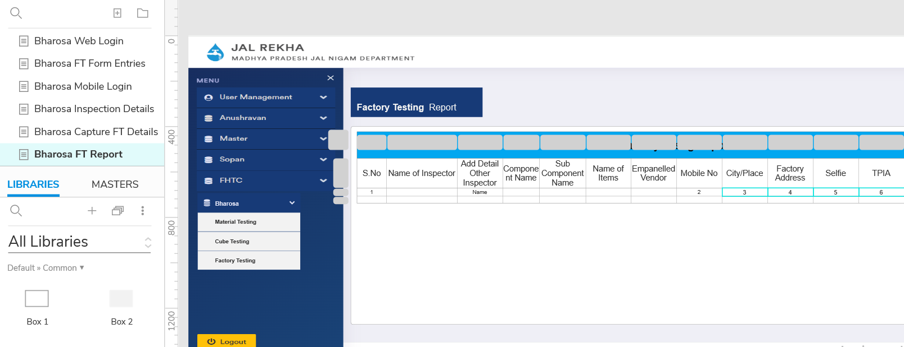
Design Documents / Impact analysis
Wireframes Link: https://172.18.200.175/svn/GIS_MAPIT/code/JalNigam/CMMI_L5_Documents/Requirements Development & Management/Wireframe
Comprehensive (HLD/LLD) design document link: https://172.18.200.175/svn/GIS_MAPIT/code/JalNigam/CMMI_L5_Documents/Technical Design Solution Document

Slide 9
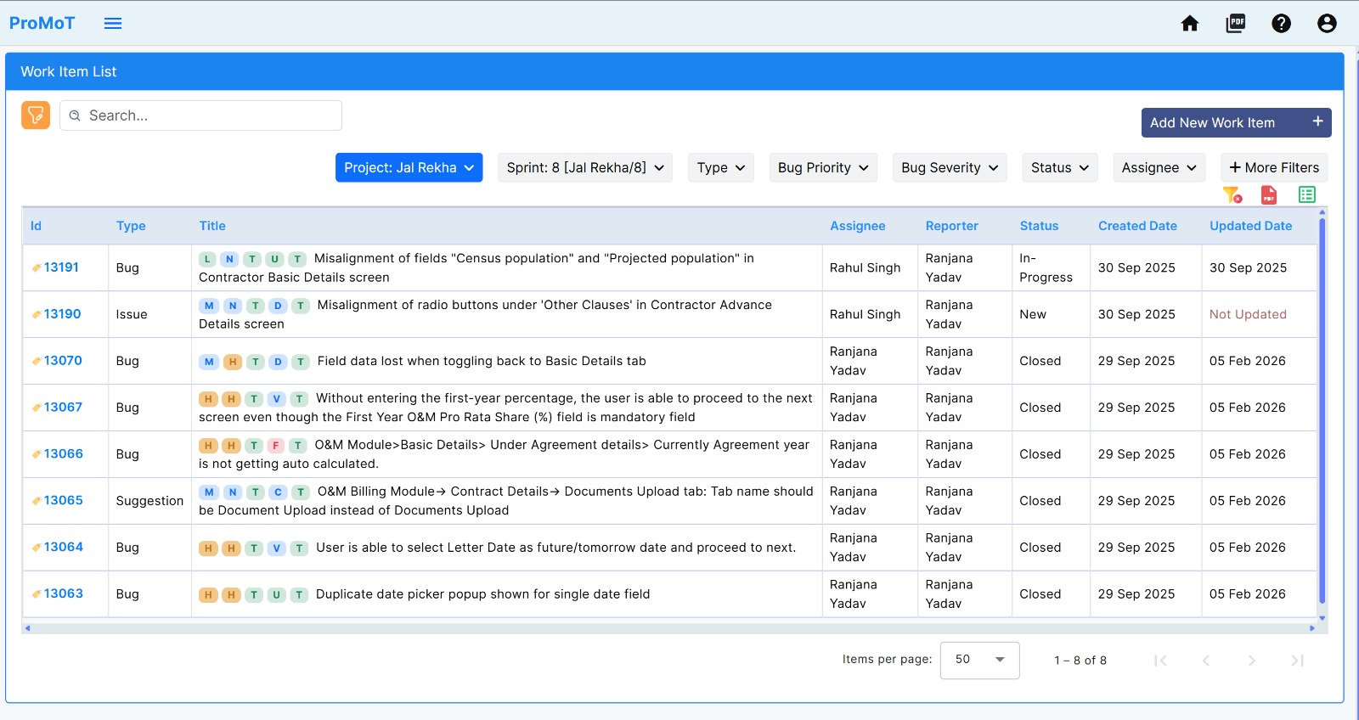
Review Log / Defect Tracker
Defect Tracker including all code review , requirement review , design , testing defects , UAT , Production defects.
Defect Tracker link: Defects are managed in PROMOT Tool, here is the reference : https://promot.mp.gov.in/
Defect Tracker screenshot:

Slide 10
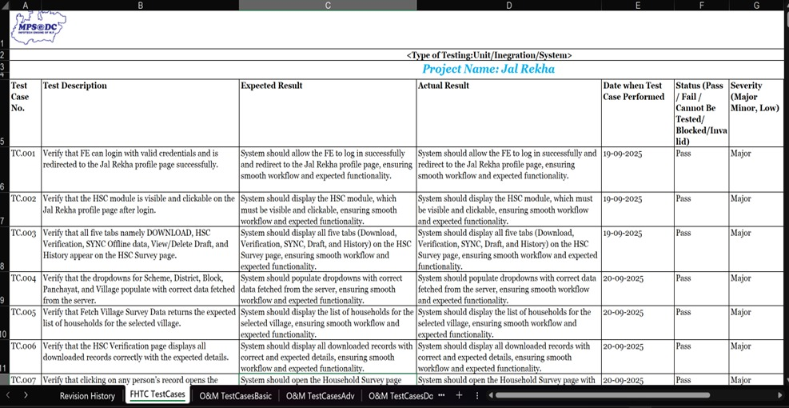
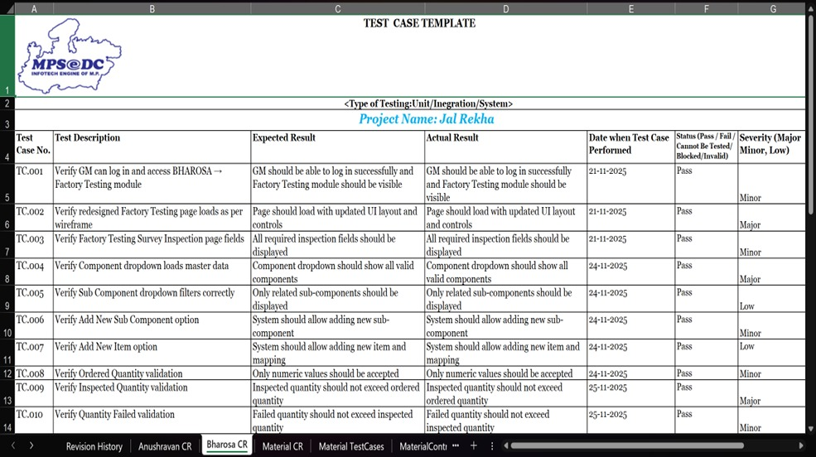
Test cases & Results
Test Cases with reference to the requirements: https://172.18.200.175/svn/GIS_MAPIT/code/JalNigam/CMMI_L5_Documents/Testing
Test Execution Results :

Slide 11
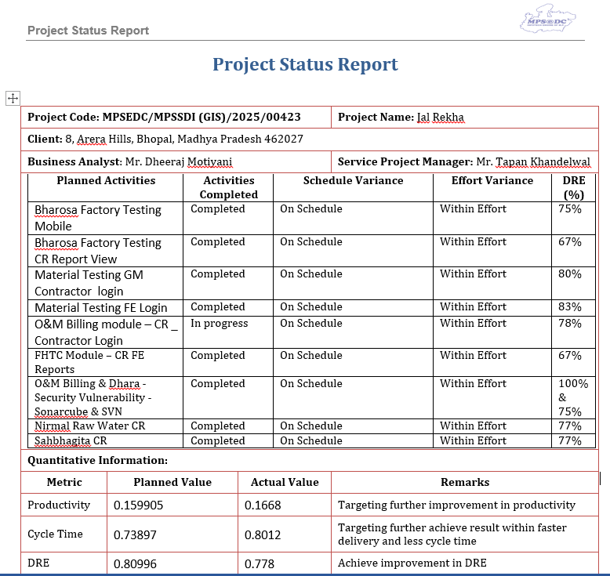
Project Monitoring & Control
Reporting KPIs planned V/S actual(PPM are shared in the
PSR for Senior Management Review)
Risk are reviewed with the tem member during the team
meeting and also shared with the SMG through PSR.
Opportunities ,
Action items of the previous meeting is tracked through MOM
Activities performed for the said duration ,
Planned activities for the upcoming duration
Project Status Report
MOM

Slide 12
KPIs (Planned V/S Actual)
For our project we follow up for 3 KPIs: Productivity, Cycle Time, and DRE
Cycle 1
Cycle 2
Cycle 3
AS-IS | Productivity | Coding Rate | Testing Rate
Mean | 0.12843 | 0.2308 | 0.858
SD | 0.009 | 0.040 | 0.294
UCL | 0.15491 | 0.3504 | 1.739
LCL | 0.10195 | 0.1113 | -0.024
Target | Productivity
Mean | 0.141273
SD | 0.05
What if | Productivity | Coding Rate | Testing Rate
Mean | 0.1411716 | 0.32 | 0.92
SD | 0.05 | 0.05 | 0.05
USL | 0.2911716 | 0.47 | 1.07
LSL | -0.0088284 | 0.17 | 0.77
AS-IS | Productivity | Code_Rate | Test_Rate
Mean | 0.1464 | 0.2833 | 0.5581
SD | 0.004 | 0.033 | 0.103
UCL | 0.15941 | 0.3831 | 0.8683
LCL | 0.13345 | 0.1836 | 0.2479
Target | Productivity
Mean | 0.16
SD | 0.05
What if | Productivity | Code_Rate | Test_Rate
Mean | 0.159905 | 0.35 | 0.69
SD | 0.050 | 0.050 | 0.050
USL | 0.309905 | 0.5 | 0.84
LSL | 0.009905 | 0.2 | 0.54
AS-IS | Productivity | Code_Rate | Test_Rate
Mean | 0.1668 | 0.2606 | 1.0753
SD | 0.005 | 0.021 | 0.064
UCL | 0.18312 | 0.325 | 0.6918
LCL | 0.15025 | 0.1961 | 0.3083
Target | Productivity
Mean | 0.18
SD | 0.05
What if | Productivity | Code_Rate | Test_Rate
Mean | 0.17929 | 0.32 | 0.7
SD | 0.050 | 0.050 | 0.050
USL | 0.32929 | 0.47 | 0.85
LSL | 0.02929 | 0.17 | 0.55
Productivity

Slide 13
KPIs (Planned V/S Actual)
For our project we follow up for 3 KPIs: Productivity, Cycle Time, and DRE
Cycle 1
Cycle 2
Cycle 3
AS-IS | Cycle time | Code_CT | Test_CT
Mean | 1.3 | 0.643 | 0.234
SD | 0.435 | 0.229 | 0.139
UCL | 2.606 | 1.329 | 0.651
LCL | -0.005 | -0.044 | -0.183
Target | Cycle time
Mean | 1.17
SD | 0.25
What if | Cycle time | Code_CT | Test_CT
Mean | 1.170848 | 0.554 | 0.21
SD | 0.25 | 0.1 | 0.5
USL | 1.920848 | 0.854 | 1.71
LSL | -0.5 | -0.2 | -1
AS-IS | Cycle time | Code_CT | Test_CT
Mean | 0.815 | 0.2968 | 0.1717
SD | 0.249 | 0.102 | 0.053
UCL | 1.561 | 0.602 | 0.3301
LCL | 0.068 | -0.0083 | 0.0133
Target | Cycle time
Mean | 0.7335
SD | 0.25
What if | Cycle time | Code_CT | Test_CT
Mean | 0.73897 | 0.2 | 0.23
SD | 0.25 | 0.1 | 0.5
USL | 1.48897 | 0.5 | 1.73
LSL | -0.01103 | -0.1 | -1.27
AS-IS | Cycle time | Code_CT | Test_CT
Mean | 0.8012 | 0.3141 | 0.1876
SD | 0.117 | 0.086 | 0.059
UCL | 1.1518 | 0.5709 | 0.3643
LCL | 0.4506 | 0.0573 | 0.011
Target | Cycle time
Mean | 0.72108
SD | 0.25
What if | Cycle time | Code_CT | Test_CT
Mean | 0.72402 | 0.25 | 0.17
SD | 0.25 | 0.1 | 0.5
USL | 1.47402 | 0.55 | 1.67
LSL | -0.02598 | -0.05 | -1.33
Cycle Time

Slide 14
KPIs (Planned V/S Actual)
For our project we follow up for 3 KPIs: Productivity, Cycle Time, and DRE
Cycle 1
Cycle 2
Cycle 3
AS-IS | DRE | Code Review Per Size
Mean | 0.756 | 0.169
SD | 0.180 | 0.159
UCL | 1.295 | 0.646
LCL | 0.217 | -0.307
Target | DRE
Mean | 0.79
SD | 0.10
What if | DRE | Code Review Per Size
Mean | 0.7952 | 0.22
SD | 0.1 | 0.05
USL | 1.0952 | 0.37
LSL | 0.4952 | 0.07
AS-IS | DRE | Code Review Per Size
Mean | 0.776 | 0.0723
SD | 0.114 | 0.029
UCL | 1.1186 | 0.1593
LCL | 0.4331 | -0.0148
Target | DRE
Mean | 0.81
SD | 0.10
What if | DRE | Code Review Per Size
Mean | 0.80996 | 0.09
SD | 0.1 | 0.05
USL | 1.10996 | 0.24
LSL | 0.50996 | -0.06
AS-IS | DRE | Code Review Per Size
Mean | 0.778 | 0.1992
SD | 0.086 | 0.062
UCL | 1.0368 | 0.384
LCL | 0.5197 | 0.0145
Target | DRE
Mean | 0.80
SD | 0.10
What if | DRE | Code Review Per Size
Mean | 0.793 | 0.22
SD | 0.1 | 0.05
USL | 1.09348 | 0.37
LSL | 0.49348 | 0.07
DRE

Slide 15
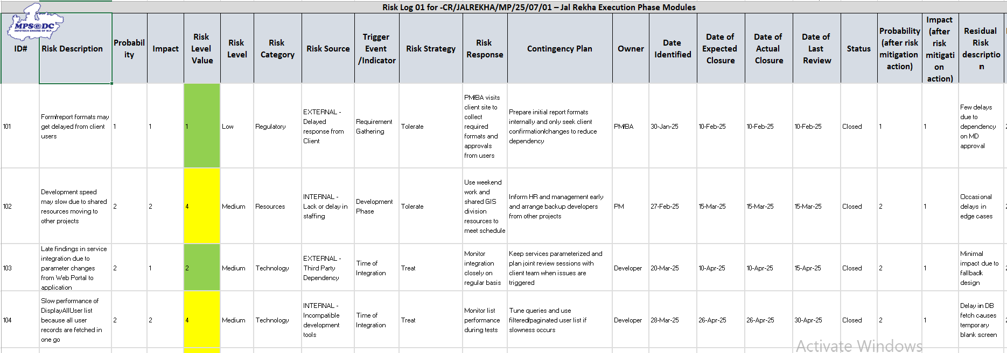
Risk & Opportunity Log
Link the Risk and Opportunity log here for the project
Screen reference of Risk log and Sheet Link: https://172.18.200.175/svn/GIS_MAPIT/code/JalNigam/CMMI_L5_Documents/Risk Opportunity Management.

Slide 16
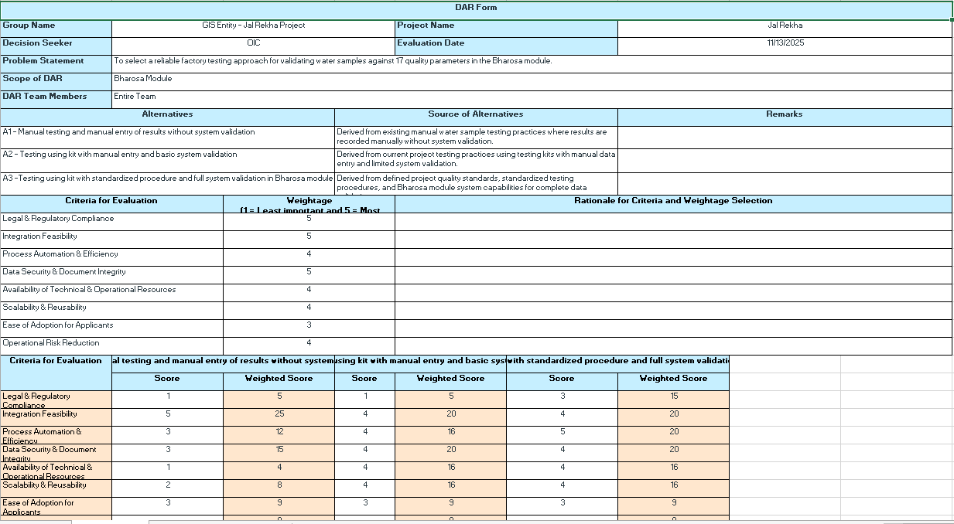
Decision Analysis & Resolution
DAR sheet for decisions taken in the projects based on the alternatives
DAR sheet Link : https://172.18.200.175/svn/GIS_MAPIT/code/JalNigam/CMMI_L5_Documents/DAR Decision Analysis Resolution

Slide 17
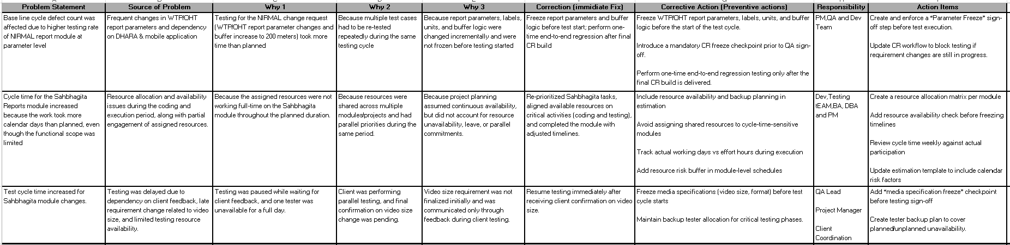
Causal Analysis & Resolution
5 why Analysis for Deviation in the KPI Performance
Major Defects / Production Defects / Deviation in the Performance : https://172.18.200.175/svn/GIS_MAPIT/code/JalNigam/CMMI_L5_Documents/Casual Analysis Resolution

Slide 18
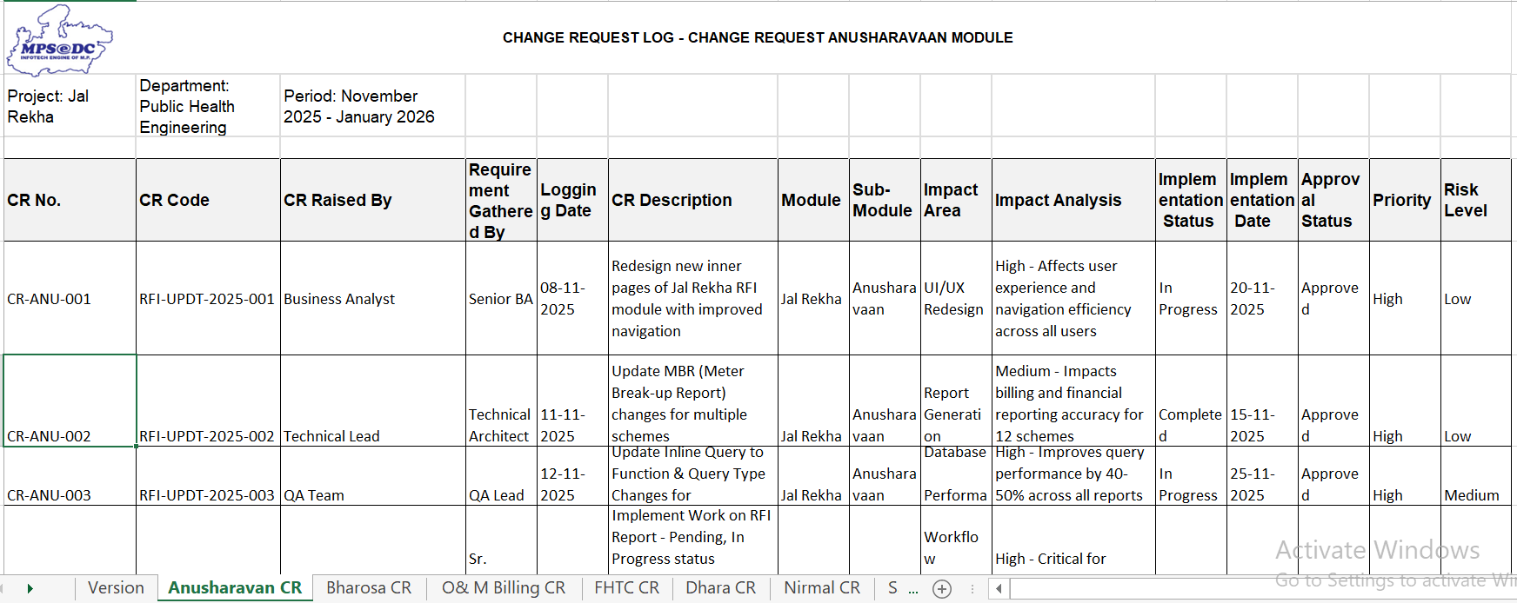
Change Management
Change request Log , Impact analysis and further procedure for the implementation of the changes
Change Request Screenshot and Sheet Link with reference to the requirements: https://172.18.200.175/svn/GIS_MAPIT/code/JalNigam/CMMI_L5_Documents/Configuration Management

Slide 19
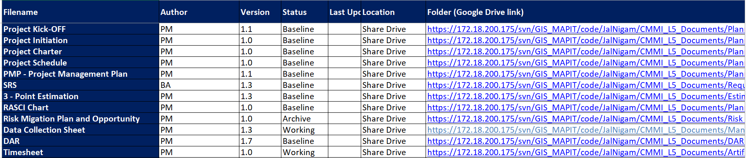
Configuration Status Accounting
Access Management on Tool , document Repository are added into SVN.
Tool used : SVN paths for all documents and Sheet Link in SVN : https://172.18.200.175/svn/GIS_MAPIT/code/JalNigam/CMMI_L5_Documents/Configuration Management

Slide 20
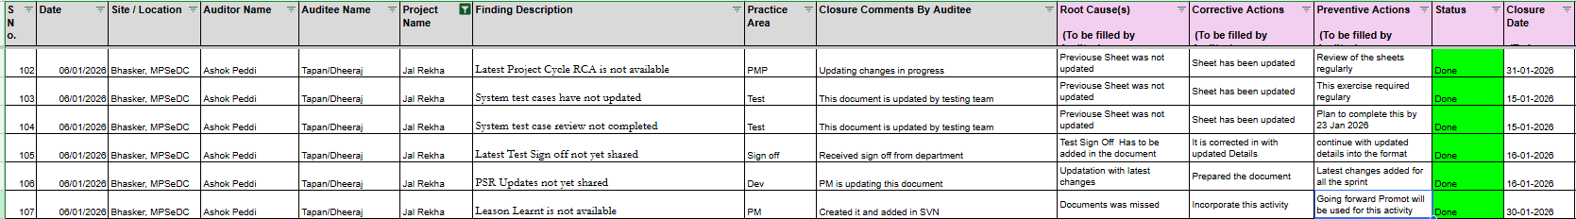
Internal Audit Report
Internal Audit Observation report with the closure of the findings.
Internal Audit reports which has the NC’s and closure of the NC’s with all root cause , Corrective and preventive action for your project

Slide 21
Lessons Learnt
Leason Learnt for Jal Rekha Project
S.N | Project - Phases / Release | What Went Right? | What Went Wrong | Lessons Learned
1 | Jal Rekha Project Web – 2025 | • Successful implementation of GIS-based data visualization for schemes, pipelines, OHT, WTP, and assets • Transparent dashboards and role-based access improved monitoring for GM, PIU, and Contractors • Design vs Actual comparison feature improved quality control • Dhara & Nirmal modules enabled effective water quantity and quality monitoring • Factory testing and inspection reports streamlined GM approvals | • Requirements were not fully frozen initially, leading to frequent change requests • GIS data handling and visualization workflows required multiple iterations • Dependency on external systems (e-Nagar Palika, master data) caused delays • Performance tuning was required for complex GIS queries and reports | • Requirement finalization workshops are essential before development • GIS-heavy modules need early prototyping and stakeholder validation • External dependency risks must be identified during planning • Early performance benchmarking avoids late-stage optimizations
2 | Jal Rekha Project Mobile – 2025 | • Offline/online data capture worked effectively for asset mapping and inspections • Geo-tagged photos and GPS-based validations improved data authenticity • Mobile traverse functionality enabled accurate field mapping • Real-time sync after connectivity restoration reduced data loss • Standardized inspection formats improved data consistency | • Initial lack of GIS concept understanding within mobile team increased defects • Offline sync conflicts occurred during high-volume data entry • Frequent change requests during UAT increased regression cycles • Field conditions (network, device constraints) impacted usability | • Mobile teams need early GIS and domain training • Offline-first design must include robust conflict resolution mechanisms • Change requests during UAT significantly impact timelines • Field usability testing is critical before statewide rollout

